Slide 1
Recap of Webinars this Year
1 New Teacher Orientation
The ‘bare bones’ of what a teacher new to the adult ESL program would need to get started
Oct. 29 Communauté en anglais at Aprescours
2 Oral Interactions
The logistics of administering oral interactions – How different centres facilitate oral interactions
Dec. 7 Communauté en anglais* at Aprescours
*Webinar divided such that you can view sections that interest you
Next and last webinar of the year
Wed. May 8 at
1:30-2:30pm

Slide 2
Teacher or PC Questions
How to correct the new exams while respecting the end-of-course outcomes?
Équipe Choc. See their previous training sessions in which they did collective corrections on their padlet, in particular, see the training session done with CSVD
Suggestion: Organize your own local / regional collective correction using the tools provided from Block 2 training, like the examples of 4101 LS Shopping for a Smart Phone or 4103 Smart Phone complaints + the Progression of Competencies
How to teach multi-level learning situations?
7 in the CCBE-DBE website to try, each with tasks that reflect specific courses as indicated on the website
See Block 2 training
See comments from training

Slide 3



Communauté anglais
Webinar 3
Thursday, March 21 at 10:30-11:30am online
Getting Your Students to Interact Orally in English in class
Ask your
questions
Share your
experiences!
Webinar will be available online afterwards @ http://aprescours.ticfga.ca/category/anglais/

Slide 4

Demographics:
Multi-level (pre-secondary to secondary 5)
Many students strong English ability
Large class size (average 15-23 students present)
Lori’s Class
Challenges to speaking English in Class
Motivated but Low Ability
Students that want to speak English but can’t
Reluctant
Students that can speak English but won’t
Students that are apathetic or do the bare minimum

Slide 5
Demographics:
Multi-level (pre-secondary to secondary 5)
Many students strong English ability
Large class size (average 15-23 students present)
Lori’s Class
Implementation of the New Program
Increase in the quantity of oral interactions in class
All (practice or exam) recorded on my iPhone
Always do an instructional grid together (student self-evaluates, then I give feedback)
Reluctant Students: not comfortable speaking English in class
option to practice private before class, or in the hall
CONS: often made me late for class (logistics of changing rooms), mildly inconvenient
PROS: reduced negative affect + immediate feedback → now, 1 year later, comfortable practicing with me in class
same options only difference is I initiate follow-up
PROS: helps the student progress through the courses
Options reduce negative affect
Feedback builds confidence

Slide 6
Demographics:
Multi-level (pre-secondary to secondary 5)
Many students strong English ability
Large class size (average 15-23 students present)
Lori’s Class
Group Instruction (Explicit Instruction)
Motivated Students with Low Ability / Reluctant beginners
Provide visual reference (write on board)
Scaffolded practice
  Pair practice while teacher circulates
  Read alouds (graded readers)
  Prompting, standing beside, direct repetition
  Group interaction
  Humour!
Simple goals=
=Attainable success
Ample support
High positive affect

Slide 7
Demographics:
Multi-level (pre-secondary to secondary 5)
Many students strong English ability
Large class size (average 15-23 students present)
Lori’s Class
Pair Work
Low Ability / Reluctant
Pair student with higher ability student
Some LSs come with a partner practice sheet or I create them
Practice in area of classroom or cafeteria
Set production parameters
Iiterative process
Paired with other students
Low negative affect
Efficient use of time
More success=
=

Slide 8
Excerpt from Équipe-Choc Training Session

Slide 9
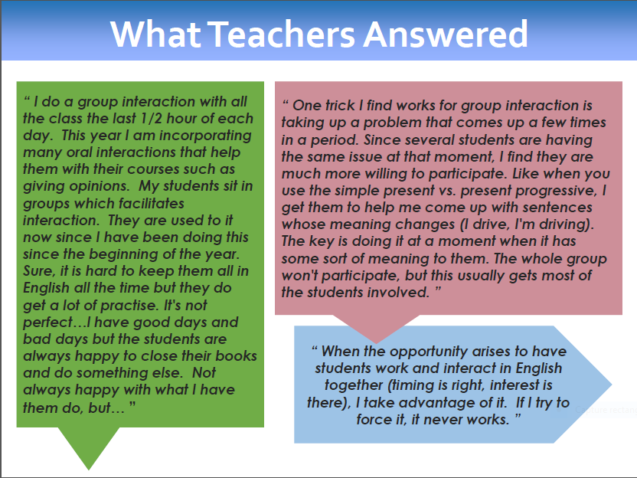
Excerpt from Équipe-Choc Training Session

Slide 10
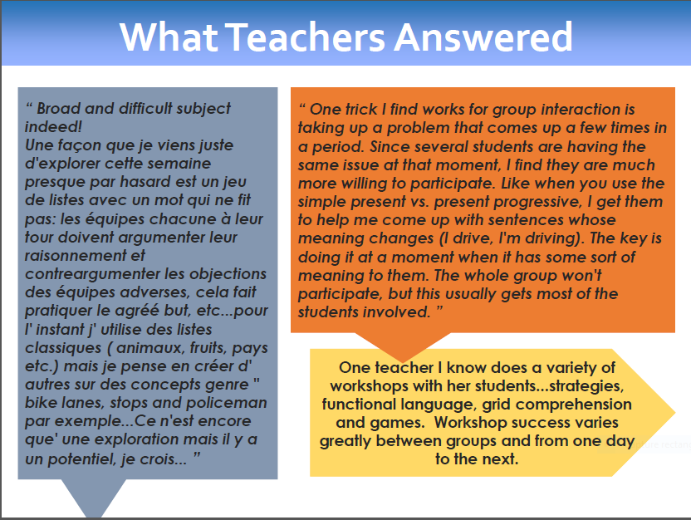
Excerpt from Équipe-Choc Training Session

Slide 11

Your Turn!
What works for you?

Slide 12
Resources
Équipe-Choc padlet for training sessions
CCBE-DBE website for multi-learning situations, training sessions, evaluation material, frequently asked questions and more
Apres Cours website for ESL webinars

