Slide 1
Optimizing Math and Science Instruction with Essential Literacy Strategies
Presented By Sonya Fiocco
PROCEDE Implementation Consultant

Slide 2
Agenda
9:45 -10:45:
Math:
Goal of the program
How the goal of the program impacts instruction and evaluation.
Literacy strategies that are aligned with competencies 1 & 2.
10:45: Break
11:00-11:45:
Science:
Goal of the program
How the goal of the program impacts instruction and evaluation.
Literacy strategies that are aligned with competencies 1,2, and 3.

Slide 3
Math

Slide 4
1) Goal of the Program
The DBE program is a competency-based program that is centered on developing mathematical knowledge and skills that are useful in dealing with many practical situations.
The DBE Math program promotes a teaching approach that aims to help students:
interpret reality
make predictions
make generalizations
make decisions

Slide 5
2) How the Goal of the DBE Program Impacts the Teaching and Learning Process
Competency Based Program = Learning Situations
Learning Situations = Series of Complex Tasks
Starts with a scenario that is meaningful/relevant to the adult learner.
Ends with a task that ultimately asks student to provide an explanation, state an opinion, make a decision, etc
“Your task is to state/explain/justify/…”
Situational Problem
Activate Prior Knowledge
Complex Task 1
Complex Task 2
Complex Task 3
Review of pre-requisite knowledge
Complex tasks build the mathematical knowledge and processes that are required to solve the situational problem. They can be purely mathematical by design.
Notes:
The contexts are related to a broad area of learning.
Provide teachers with a list of scenarios that are suitable for adult learners.

Slide 6
A Sample Learning Situation
Situational Problem
Activate Prior Knowledge
Complex Task 1
Complex Task 2
Complex Task 3
Complex Task 4

Slide 7
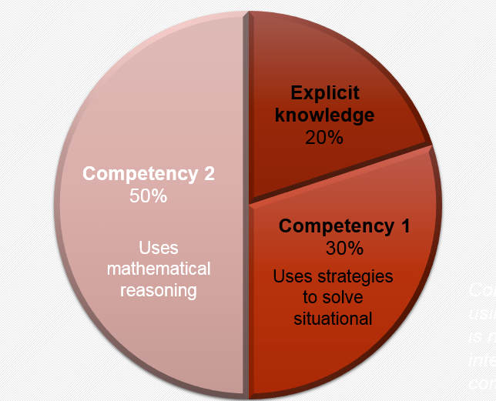
3) How the Goal of the Program Impacts the Evaluation Scheme
Competency–Based Evaluation Scheme

Slide 8
4) How the Goal of the Program Influences the Evaluation Criteria
Competency 1: Uses Strategies to Solve Situational Problems
Competency 2: Uses Mathematical Reasoning
2.2 Proper implementation of mathematical reasoning suited to the situation.
1.2 Application of strategies and appropriate mathematical knowledge.
2.1 Correct use of appropriate mathematical concepts and processes.
2.3 Proper organization of the steps in an appropriate procedure.
1.1 Indication that the situational problem has been understood.
1.1
Comprehension
1.2
Representation
2.2
Organization
2.1
Application
2.3
Communication

Slide 9
A Case for Literacy Instruction in the DBE Math Classroom

Slide 10
Competency 1: Uses Strategies to Solve Situational Problems
Comprehension
Representation
Notes:
http://web.a.ebscohost.com/ehost/detail/detail?vid=0&sid=a940a30d-1038-4643-b5c6-35eacf4f5d02%40sdc-v-sessmgr06&bdata=JnNpdGU9ZWhvc3QtbGl2ZQ%3d%3d#AN=37138527&db=ehh

Slide 11
Problem Areas With Competency 1
Mathematical texts can contain more concepts per line, sentence, and paragraph than any other kind of texts.
Students must be able decode and comprehend mathematical signs, symbols, and graphics.
Students also need to read and interpret information presented in unfamiliar ways—not only left to right, but also right to left (number lines), top to bottom (tables), and even diagonally (graphs).
Words that are common in the English language may have a different meaning in mathematics.
(Kester Phillips, Bardsley, Bach, Gibb-Brown, 2009; p. 468
Barton, Heidema, and Jordan, 2002, p.24)

Slide 12
Literacy Strategies that Assist With Competency 1: (Comprehension & Representation)
Strategies | Description | Why Use This Strategy | How to Use This Strategy (Methods and Tools)
Vocabulary
Identify Key Words and Content-Area Vocabulary | Identifying and decoding words that are essential to the conceptual understanding of the problem. (Students may struggle with concept words or difficult vocabulary). | Words in the English language sometimes mean something different in the math classroom. Allows students to concentrate on words that will allow them to eventually solve the problem. | Vocabulary Table Verbal Visual Word Association Frayer Model Word Wall
Comprehension and Representation
Guided Comprehension of Word Problems | A list of questions that help the student process the math problem and make them metacognitive aware of what they are reading. | Helps students fully understand the problem solving thought process. Good strategy for low achieving math students. | CUBE Method Guided Question
Graphics Organizers | Graphical tool for organizing and representing knowledge. | Provides a visual representation of key concepts and related terms. This helps students make connections, explain relationships and retain information. | Concept Maps Classification Diagrams Venn Diagrams Tables Graphs
Capelli, 2015
Notes:
Hand out journal of inquiry table
A concept map is a diagram showing the relationships among concepts. They are graphical tools for organizing and representing knowledge.
A flow Chart is a schematic representation of a sequence of operations

Slide 13
Competency 2: Uses Mathematical Reasoning
Organization
Application
Communication

Slide 14
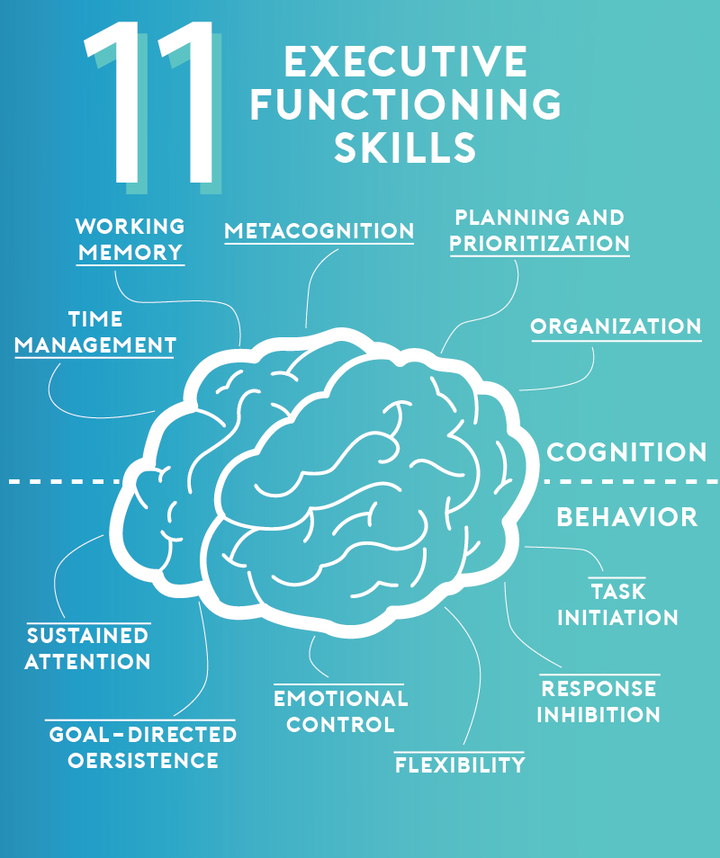
Problem-Areas With Competency 2
Criteria 2.1 and 2.2:
Require strong Executive Function (EF)
Individuals with executive function problems have
difficulty with planning, organizing and managing time and space.
National Center for Learning Disabilities (NCLD)
Notes:
https://mathsolutions.com/wp-content/uploads/2004_Writing_in_Math.pdf
https://files.eric.ed.gov/fulltext/ED544239.pdf

Slide 15
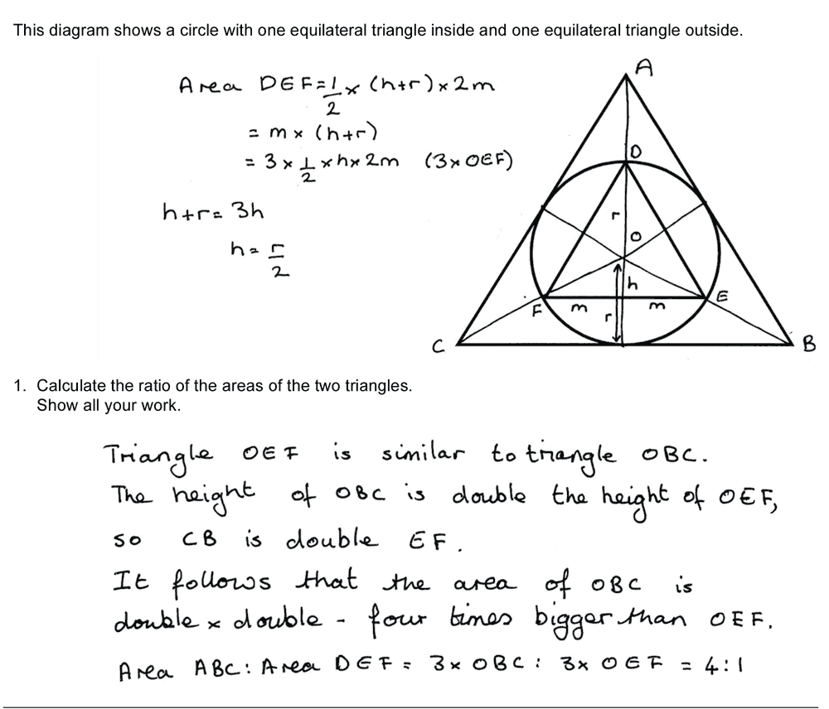
Problem Areas With Competency 2
Criterion 2.3:
Writing in math class differs from other subjects.
Must use various registers of representation (e.g. words, symbols, figures, diagrams/graphs, tables) to convey the solution.
Must use the rules and conventions of mathematical language.

Slide 16
Literacy Strategies that Assist with Competency 2: Mathematical Reasoning (Organization, Application, Communication)
Strategies | Description | Why Use the Strategy | How to Use This Strategy (Methods and Tools)
Organization & Application Strategies
Creating Task Lists | A “to-do” list that breaks the problem into sub-problems. | Helps students organize their thoughts, deliver a structured response, and show their line of reasoning. | Task List Template * Teachers should model for the first couple of times.
More Than One Strategy exercise | Asking students to offer more than one way to arrive at an answer. | Helps students become flexible in their mathematical thinking and to look at problems from different perspectives. | Multiple Solution Representation Sheet
Class Inventories | Collecting and reviewing a list of strategies that students use to solve a particular math problem. | Students learn different strategies from one another. Teacher gets a sense of the class’s progress. | Solution Inventory Sheet
Communication/ Writing Strategies
Correcting “other students” answers. | Student corrects another student’s answer to a problem. | Helps the student convey a mathematical message using mathematical rules and conventions. | Correct the Student’s Answer Sheet
Summative Writing Prompts | Student summary of math learning (can be done at the end of each chapter, mid-session, end-of-session). | Requires students to reflect and write about the rules, formulas, shapes, etc, that they learned. | N/A
Capelli, 2015; Adams & Pegg, 2012;Burns, 2005; Burns, 2004;
Notes:
http://writingfix.com/WAC/numberfix.htm
https://mathsolutions.com/wp-content/uploads/2005_How_Students_Reason.pdf
https://mathsolutions.com/wp-content/uploads/2004_Writing_in_Math.pdf

Slide 17
Tying it all together :
Problem Solving Template
Problem Solving Checklist
Decision Guide (to come)
Notes:
https://slideplayer.com/slide/4881881/

Slide 18
The DBE Science and Technology Program

Slide 19
1) Goals of the Program
The DBE Science & Technology program promotes a teaching approach that aims to help students:
acquire scientific knowledge, methods, and techniques.
develop their scientific and technological literacy so that they can make informed decisions
adopt a critical attitude toward ethical issues related to science and technology
adopt careful and methodological work habits

Slide 20
2) How the Goal of the Program Impacts the Teaching and Learning Process
Situational Problem
Activate Prior Knowledge
Complex Task 1
Complex Task 2
Complex Task 3
Competency Based Program = Learning Situations
Learning Situations = Series of Complex Tasks

Slide 21
A Sample Learning Situation
Situational Problem
Activate Prior Knowledge
Complex Task 1
Complex Task 2
Complex Task 3

Slide 22
3) How the Goal of the Program Impacts the Evaluation Scheme
Practical Exam (40% of final grade)
Competencies 1 and 3
Focuses on technique
Results not as important as concept planning, methodology, explanation.
Theoretical exam (60% of final grade)
Competencies 2 and 3
LES-type questions (40%)
Six to eight explicit knowledge questions (20%).

Slide 23
4) How the Goal of the Program Influences the Evaluation Criteria
Competency 1: Seeks answers or solutions to scientific or technological problems.
1.1 Appropriate representation of the situation
Competency 2: Makes the most of his or her knowledge of science and technology.
2.1 Accurate interpretation of the problem
Competency 3: Communicates in the languages used in science and technology.
1.2 Development of a suitable plan of action
1.3 Appropriate implementation of the plan of action
1.4 Development of relevant explanations, solutions or conclusions.
2.2 Relevant use of scientific and technological knowledge
2.3 Appropriate formulation of explanations or solutions
Comprehension
Representation
Organization
Application
Communication

Slide 24
A Case for Literacy Instruction in the DBE Science & Technology Classroom

Slide 25
Competency 1: Seeks answers or solutions to scientific or technological problems.
LABS
Notes:
Show template and scaffolding

Slide 26
Problem-Areas for Competency 1
In addition to reading and understanding the problem, the practical component of the course requires strong Executive Function.

Slide 27
Literacy Strategies that Help With Competency 1
Strategies | Description | Why Use the Strategy | Tools and Techniques
Vocabulary:
Identify Key Words | Identifying and decoding words that are essential to the conceptual understanding of the text. | Words in the English language sometimes mean something different in the math classroom. Allows students to concentrate on words that will allow them to eventually solve the problem. | Frayer Model Verbal Visual Word Association (VVWA)
Reading Comprehension and Representation (1.1)
Graphic Organizers | Visual and spatial representations of information and relationships found within text. They are typically a one page combination of words and diagrams. | Increases comprehension by helping students make connections, explain relationships or scientific principles and retain information. This strategy also develops students’ abilities to make predictions and identify patterns. | Flow charts, Venn diagrams T-chart, Concept maps. Most effective when teachers model how to use them.
Organization, Application, and Communication (1.2-1.4)
Writing prompts | A sentence starter that keeps the writing focused. | Helps students understand and correctly complete each section of the lab report. | Lab Report Template with prompts
Seddon, 2017; Adams & Pegg, 2012

Slide 28
Competency 2: Makes the most of his or her knowledge of science and technology.
Evaluation Criteria for Competencies 2 and 3 (Theory)
2.1 Accurate interpretation of the problem
2.2 Relevant use of scientific and technological knowledge
2.3 Appropriate formulation of explanations or solutions

Slide 29
Problem Areas with Competency 2
Reading scientific texts can be challenging for students due to the high concentration of abstract ideas, technical vocabulary, and various text forms.

Slide 30
Literacy Strategies that Assist with Competency 2
Strategies | Description | Why Use the Strategy | How to Use This Strategy (Methods and Tools)
Vocabulary (2.1)
Identify Key Words | Identifying and decoding words that are essential to the conceptual understanding of the text. | Words in the English language sometimes mean something different in the math classroom. Allows students to concentrate on words that will allow them to eventually solve the problem. | Frayer Model Verbal Visual Word Association (VVWA)
Reading Comprehension & Representation (2.1 & 2.2)
Annotation of Text | Students make markings in the text in places where they make connections or have questions. Markings including symbols, phrases, and reflections are typically written in the margins or within the text. | The student sees reading as an active process of comprehension or way of learning. Slows the reading down and provides students with a visible record of their thoughts. Encourages students to make predictions, ask questions, make connections, define vocabulary, state opinions, reflect on content, and patterns or trends in the reading. | Tell students why they are reading a particular piece of text and what they will do with it when they are done reading. Have a bookmark of symbols that represent categories of annotations.
Anticipation Reading Guides | Before reading a text, students are challenged to agree or disagree to a series of statements and justify their opinions in writing. | Provides students with practice in finding supporting evidence concerning (controversial) topics. Students identify their prior knowledge, reveal preconceptions, and prepare to read with understanding | Use prior to annotating texts. Create a sheet of 6-8 statements. Have students read, react, and justify or revise their positions using evidence from the text.
Graphic Organizers | Visual and spatial representations of information and relationships found within text. They are typically a one page combination of words and diagrams. | Increases comprehension by helping students make connections, explain relationships and retain information. This strategy also develops students’ abilities to make predictions and identify patterns. They can be employed during all stages of reading (pre-reading, during reading, or post reading). | KWS Organizer Flow chart Venn diagram T-chart Concept map Most effective when teacher models how to use them.
Communication (2.3)
Journal prompts, guided note-taking, or reflection questions | Serve as brief summaries of concepts or learning activities. | Helps students recall information that they had learned or record information as it is being presented | Student Reflection Questions (by Edutopia)
(Sedden, 2017, p. 18-26; Adams & Pegg, 2012)
Notes:
https://scholarworks.uni.edu/cgi/viewcontent.cgi?article=1115&context=grp
http://blogs.4j.lane.edu/literacyresources/files/2015/10/Literacy-Standards-Science-Math.pdf

Slide 31
Important to Remember
Each strategy requires explicit instruction and modeling by the teacher to be effective.
Purposeful planning of which and when to use literacy strategies is necessary for students to build capacity and take ownership of their reading or writing to learn.

Slide 32
References
Adams, A. E., & Pegg, J. (2012). Teachers’ enactment of content literacy strategies in secondary science and mathematics classes. Journal of Adolescent & Adult Literacy, 56(2), 151-161.
Barton, M. L., Heidema, C., & Jordan, D. (2002). Teaching Reading in Mathematics and Science. Educational leadership, 60(3), 24-28.
Brown, S. A. (1995). The mathematics learning log and its effects on mathematics achievement, anxiety, and communication (Doctoral dissertation, Montana State University-Bozeman, College of Education, Health & Human Development).
Burns, M. (2005). Looking at How Students Reason [Ebook] (pp. 1-6). Retrieved from http://citeseerx.ist.psu.edu/viewdoc/download;jsessionid=81713074A746F8FAC9C4FD4F2EF82AE2?doi=10.1.1.510.372&rep=rep1&type=pdf
Burns, M. (2004). Writing in math. Educational Leadership, 62(2), 30-33.
Cappelli, A. (2015). Implementing Literacy Strategies and Activities to Help Math Students in Geometry.
del Prado Hill, P., Friedland, E. S., & McMillen, S. (2016). Mathematics-Literacy Checklists: A Pedagogical Innovation to Support Teachers as They Implement the Common Core. Journal of Inquiry and Action in Education, 8(1), 23-38.
Friedland, E. S., McMillen, S. E., & del Prado Hill, P. (2011). Collaborating to cross the mathematics–literacy divide: An annotated bibliography of literacy strategies for mathematics classrooms. Journal of Adolescent & Adult Literacy, 55(1), 57-66.Kester Phillips, D. C., Bardsley, M. E., Bach, T., & Gibb-Brown, K. (2009). " BUT I TEACH MATH!'THE JOURNEY OF MIDDLE SCHOOL MATHEMATICS TEACHERS AND LITERACY COACHES LEARNING TO INTEGRATE LITERACY STRATEGIES INTO THE MATH INSTRUCTION. Education, 129(3).
Grenell, A. (2019). Literacy: What does Executive Function have to do with it? - Reflection Sciences. [online] Reflection Sciences. Available at: https://reflectionsciences.com/literacy-executive-function/ [Accessed 23 Jan. 2019].
Seddon, M. (2017). Strategies for integrating literacy into a science classroom.

